Slide 1
Faculty Introduction - Syed Rizvi

Slide 2
Introduction
14 plus years of experience in java, advance java and data processing technologies, mainly at the technical architecture level.
Worked with various multinationals like Deloitte, TCS and MphasiS
Rich expereince in Hadoop Stack
IBM, MongoDB and Hortonworks Hadoop Certified.
Data Science Certified from Edureka
PGDBA – ICFAI Mumbai (Information Technology)
Enjoy teaching and sharing knowledge.

Slide 3
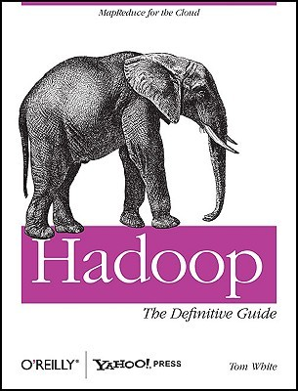
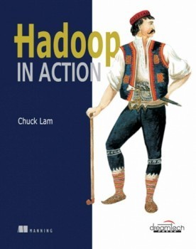
Recommended Books

